Slide 1
Data Communication and Networking (DCAN 202)
Week 7

Slide 2
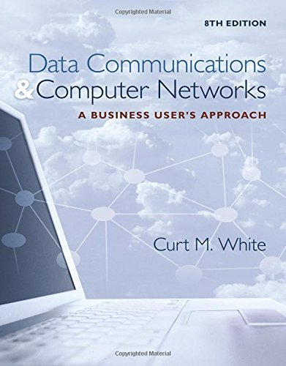
Chapter 10: The Internet
Data Communications and Computer Networks: A Business User's Approach, Eighth Edition
© 2016. Cengage Learning. All right reserved.

Slide 3
Todays Lecture
How Internet Protocol (IP) can be used to create a connection between networks
How Transmission Control Protocol (TCP) can be used to create a reliable, end-to-end network connection
Relationships between TCP/IP and the protocols ICMP, UDP, ARP, DHCP, NAT, and tunneling protocols
How Domain Name System converts a URL into a dotted decimal IP address
Major Internet applications and services
IPv6, Internet2 and the evolution of Internet

Slide 4
Introduction
Today’s present Internet is a vast collection of thousands of networks and their attached devices
The Internet began as ARPANET during the 1960s
One high-speed backbone connected several university, government, and research sites
Backbone was capable of supporting 56 kbps transmission speeds and eventually became financed by the National Science Foundation (NSF)

Slide 5
Internet Protocols
To support the Internet and all its services, many protocols are necessary
Some of the protocols that we will look at:
Internet Protocol (IP)
Transmission Control Protocol (TCP)
Address Resolution Protocol (ARP)
Dynamic Host Configuration Protocol (DHCP)
Network Address Translation (NAT)

Slide 6
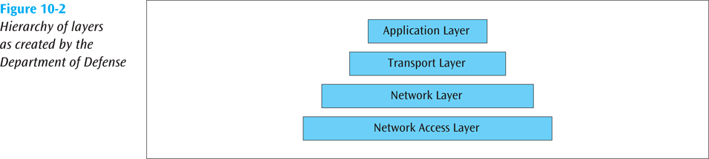
Internet Protocols (continued)
Recall that the Internet with all its protocols follows the TCP/IP protocol suite (Internet model)
An application, such as e-mail, resides at the highest layer
A transport protocol, such as TCP, resides at the transport layer
The Internet Protocol (IP) resides at the Internet or network layer
A particular media and its framing resides at the network access (or data link) layer
Hierarchy of layers as created by Dept. of Defense (US)
Data Communications and Computer Networks: A Business User's Approach, Eighth Edition
© 2016. Cengage Learning. All Rights Reserved.

Slide 7
The Internet Protocol (IP)
IP prepares a packet for transmission across the Internet
The IP header is encapsulated onto a transport data packet
The IP packet is then passed to the next layer where further network information is encapsulated onto it

Slide 8
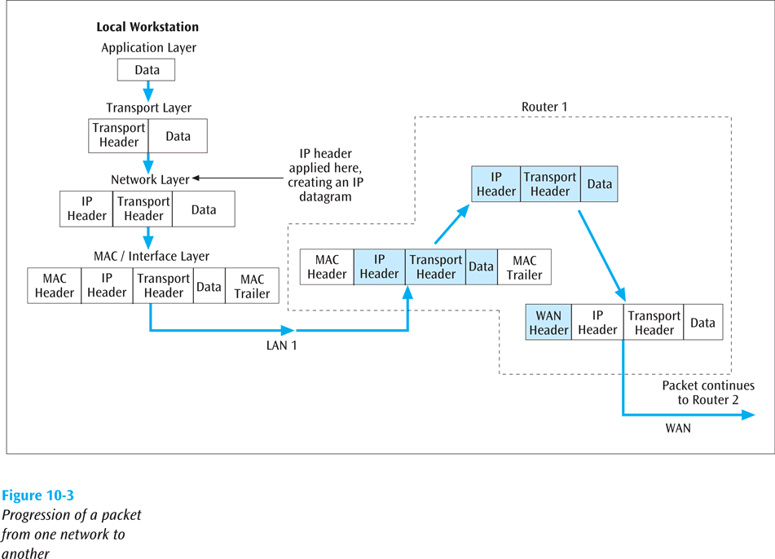
The Internet Protocol (IP) (cont.)
Data Communications and Computer Networks: A Business User's Approach, Eighth Edition
© 2016. Cengage Learning. All Rights Reserved.
Progression of packet from one network to another

Slide 9
The Internet Protocol (IP) (continued)
There are currently two versions of IP:
Version 4, which has been in existence for many years
IPv4 32 bit binary number - supports 4 Billion Devices.
Version 6, which has been available for several years but is only now starting to see a substantial move towards replacing version 4
Let’s take a look at both versions

Slide 10
IPv4 Addresses
All devices connected to Internet have a 32-bit IP address
Think of the IP address as a logical address (possibly temporary), while the 48-bit address on every NIC is the physical, or permanent address
Computers, networks and routers use the 32-bit binary address, but a more readable form is the dotted decimal notation

Slide 11
IPv4
Example: 192 . 168 . 0 . 2
11000000 . 10101000 . 00000000 . 00000010
Network ID
Host ID
32 Bit Binary Value
Subnet Mask:
255.255.255.0
11111111. 11111111. 11111111.00000000

Slide 12
Subnet Mask
192 . 168 . 0 . 2 / 24
Slash Notation
11111111. 11111111. 11111111. 00000000
255.255.255.0
Dotted Decimal Notation

Slide 13
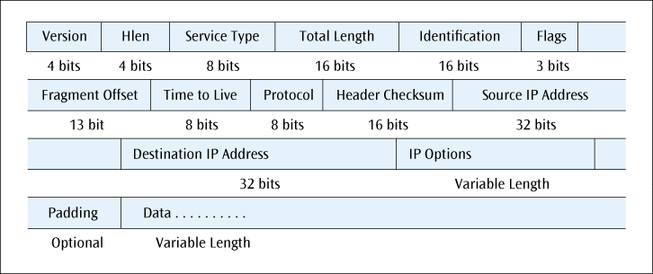
The IPv4 Header/Datagram
Format of the IPv4 datagram
Data Communications and Computer Networks: A Business User's Approach, Eighth Edition
© 2016. Cengage Learning. All Rights Reserved.

Slide 14
IPv4 Addresses (continued)
Class A addresses : 0 – 127 Default Subnet Mask: 255.0.0.0
Class B addresses :128 – 191 Default Subnet Mask: 255.255.0.0
Class C addresses :192 – 223 Default Subnet Mask: 255.255.255.0
All Class D addresses are in the range 224 – 239
All Class E addresses are in the range 240 - 255

Slide 15
IPv4 Addresses (continued)
Class A
0.X.X.X
127.X.X.X
2²⁴ = 16,777,214 Hosts
255.0.0.0
11111111.00000000. 00000000. 00000000
Class B
128.X.X.X
191.X.X.X
2¹⁶ = 65,534 Hosts
255.255.0.0
11111111. 11111111. 00000000. 00000000
Class C
192.X.X.X
223.X.X.X
2⁸ = 254
Hosts
255.255.255.0
11111111. 11111111. 11111111. 00000000

Slide 16
IPv4 Addresses (continued)
When IP addresses were originally created, they were called classful addresses
That is, each IP address fell into particular class
A particular class address has a unique network address size and a unique host address size
There are basically five types of IP addresses: Classes A, B, C, D and E

Slide 17
IPv4 Addresses (continued)
IP subnet masking
Sometimes you have a large number of IP addresses to manage
By using subnet masking, you can break the host ID portion of the address into a subnet ID and host ID
Example – subnet mask 255.255.255.0 applied to a class B address will break the host ID (normally 16 bits) into an 8-bit subnet ID and an 8-bit host ID

Slide 18
IPv4 Addresses (continued)
Today, IP addresses are considered classless addresses
With classless addressing, companies (users) do not apply for particular class of addresses
Instead, company will get its IP addresses from an Internet service provider (ISP)
Most ISPs have already applied for a large number of IP addresses and are willing to lease those addresses to companies

Slide 19
IPv4 Addresses (continued)
Example – instead of applying for two Class C addresses, a company could contact an ISP, which would lease 500 IP addresses to the company
The addresses are not identified by any class – they are simply a contiguous block of IP addresses
Classless addressing has led to a much more efficient allocation of the IP address space
A company can lease only as many addresses as it needs

Slide 20
Classless IPv4 Addresses
167 . 199 . 170 . 82 / 24
11111111. 11111111. 11111111. 00000000
255.255.255.0
24 bits belong to the network ID, and 8 bits belong to the host ID
The number of Hosts: 2⁸ = 254
167.199.170.82 / 27
11111111. 11111111. 11111111. 11100000
The network mask has 27 of 1s followed by 5 of 0s.
27 bits belong to the network ID, and 5 bits belong to the host ID
Subnet Mask in dotted decimal notation that is 255.255.255.224.
The number of Hosts: 2⁵ = 32

Slide 21
Classless IPv4 Addresses
To find the first address, AND the address (167.199.170.82) with the network mask (255.255.255.224)
Address: 10100111 11000111 10101010 01010010
Mask: 11111111 11111111 11111111 11100000
Result: 10100111 11000111 10101010 01000000
Which in decimal is 167.199.170.64/27
The last address is 31 addresses past the first, or 167.199.170.95/27

Slide 22
IP Subnet Calculator
Some Helpful Links for calculation:
https://www.calculator.net/ip-subnet-calculator.html
http://jodies.de/ipcalc
http://www.aboutmyip.com/AboutMyXApp/IP2Integer.jsp

Slide 23
IP Addresses
Private IP vs Public IP
Static IP vs Dynamic IP
https://www.youtube.com/watch?v=WsZPwRkKiQ8

Slide 24
Private IP Address Range
The Internet Assigned Numbers Authority (IANA) has assigned several address ranges to be used by private networks.
Address ranges to be use by private networks are:
Class A
10.0.0.0
10.255.255.255
255.0.0.0
Class B
172.16.0.0
172.31.255.255
255.255.0.0
Class C
192.168.0.0
192.168.255.255
255.255.255.0

Slide 25
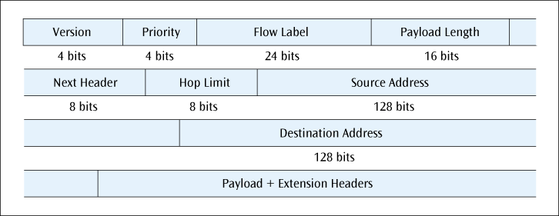
IPv6
The next version of the Internet Protocol
Main features include:
Simpler header
128-bit IP addresses
Priority levels and quality of service parameters
No fragmentation
The fields in the IPv6 header
Data Communications and Computer Networks: A Business User's Approach, Eighth Edition
© 2016. Cengage Learning. All Rights Reserved.

Slide 26
IPv6 Addresses
IPv6 addresses are 128-bits in size (2¹²⁸ is a very large number!)
They are also classless addresses, similar to IPv4 addresses
Because of their size, a number of conventions have been adopted:

Slide 27
IPv6 Addresses
Binary addresses are written using the short-hand hexadecimal form:
0110 1010 0011 1110 1011 1010 … 1110 1111
6A3E : BA91 : 7221 : 0000 : 01FC : 922C : 877B : FFEF
Four hex 0s in a row are truncated as follows:
6A3E : BA91 : 7221 : 0 : 01FC : 922C : 877B : FFEF

Slide 28
IPv6 Addresses
Longer strings of 0s can be abbreviated further. For example,
6A3E : BA91 : 0 : 0 : 0 : 0 : 877B : FFEF
can be abbreviated as
6A3E : BA91 : : 877B : FFEF

Slide 29
The Transmission Control Protocol (TCP)
TCP layer creates connection between sender and receiver using port numbers
The port number identifies a particular application on a particular device (IP address)
TCP can multiplex multiple connections (using port numbers) over a single IP line
Example:
Port 25: Simple Mail Transfer Protocol (SMTP) used by e-mail servers
Port 53: DNS protocol
Port 80: HTTP - Used for accessing Web servers
Port 443: HTTPS – Secured HTTP
Port 110: The POP service or Post Office Protocol used by local e-mail clients

Slide 30
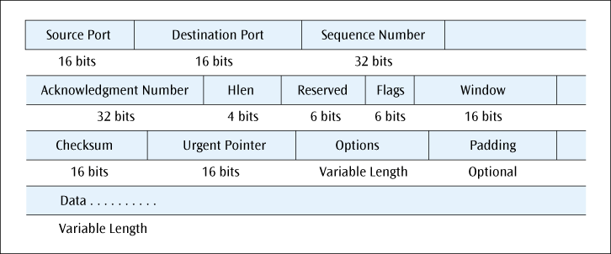
The Transmission Control Protocol (TCP) (continued)
The TCP layer can ensure that the receiver is not overrun with data (end-to-end flow control) using the Window field
TCP can perform end-to-end error correction
Checksum
TCP allows for the sending of high priority data
Urgent Pointer
The fields of the TCP header

Slide 31
Internet Control Message Protocol (ICMP)
ICMP
Used by routers and nodes
Performs error reporting for the Internet Protocol
ICMP reports errors such as invalid IP address, invalid port address, and the packet has hopped too many times

Slide 32
User Datagram Protocol (UDP)
A transport layer protocol used in place of TCP
Where TCP supports a connection-oriented application, UDP is used with connectionless applications
UDP also encapsulates a header onto an application packet but the header is much simpler than TCP (16-bit source port, 16-bit dest port, 16-bit length of entire packet, 16-bit checksum)

Slide 33
Address Resolution Protocol (ARP)
When an IP packet has traversed the Internet and encounters the destination LAN, how does the packet find the destination workstation?
Even though destination workstation may have an IP address, a LAN does not use IP addresses to deliver frames
A LAN uses MAC layer address
ARP translates IP address into MAC layer address so frame can be delivered to proper workstation

Slide 34
Dynamic Host Configuration Protocol (DHCP)
An IP address can be assigned to a workstation permanently (static assignment) or dynamically
Dynamic IP address assignment is a more efficient use of scarce IP addresses
When DHCP client issues an IP request, DHCP server looks in its static table
If no entry exists, server selects an IP address from available pool

Slide 35
Dynamic Host Configuration Protocol (DHCP) (continued)
The address assigned by DHCP server is temporary
Part of agreement includes specific period of time
If no time period specified, the default is one hour
DHCP clients may negotiate for a renewal before the time period expires

Slide 36
Network Address Translation (NAT)
NAT lets router represent entire local area network to Internet as single IP address
Thus, all traffic leaving LAN appears as originating from global IP address
All traffic coming into this LAN uses this global IP address
This security feature allows a LAN to hide all the workstation IP addresses from the Internet

Slide 37
Network Address Translation (NAT) (continued)
Since the outside world cannot see into LAN, you do not need to use registered IP addresses on inside LAN
We can use the following blocks of addresses for private use:
10.0.0.0 – 10.255.255.255
172.16.0.0 – 172.31.255.255
192.168.0.0 – 192.168.255.255

Slide 38
Network Address Translation (NAT) (continued)
When a user on inside sends packet to outside, the NAT interface changes the user’s inside address to global IP address
This change is stored in a cache
When the response comes back, the NAT looks in cache and switches the addresses back
If not the packet is dropped
Unless NAT has a service table of fixed IP address mappings
This service table allows packets to originate from the outside

Slide 39
Tunneling Protocols and Virtual Private Networks (VPNs)
The Internet is not normally a secure system
If person wants to use Internet to access corporate computer system, how can a secure connection be created?
One possible technique is by creating a virtual private network (VPN)
VPN creates a secure connection through the Internet by using a tunneling protocol

Slide 40
The World Wide Web
The World Wide Web (WWW) – immense collection of web pages and other resources that can be downloaded across the Internet and displayed on a workstation via a web browser and is the most popular service on the Internet
Basic web pages are created with the Hypertext Markup Language (HTML)
Hypertext Transport Protocol (HTTP) is protocol to transfer a web page

Slide 41
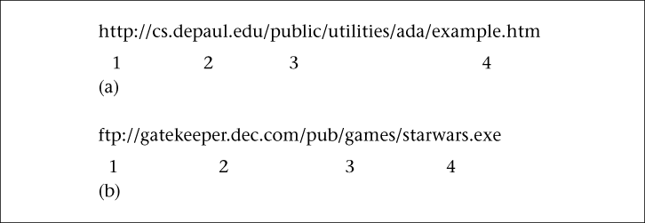
Locating a Document on the Internet
Every document on the Internet has a unique Uniform Resource Locator (URL)
All URLs consist of four parts:
Service type
Host or domain name
Directory or subdirectory information
Filename
The parts of a Uniform Resource Locator (URL) for HTTP (a) and FTP (b)

Slide 42
Locating a Document on the Internet (continued)
When a user, running a Web browser, enters a URL, how is URL translated into an IP address?
Domain Name System (DNS) – large, distributed database of URLs and IP addresses
The first operation performed by DNS is to query a local database for URL/IP address information
If local server does not recognize address, the server at next level will be queried
Eventually root server for URL/IP addresses will be queried
If root server has answer, results are returned
If root server recognizes domain name but not extension in front of domain name, root server will query server at domain name’s location
When domain’s server returns results, they are passed back through chain of servers (and their caches)

Slide 43
Internet Services
The Internet provides many types of services, including several very common ones:
Electronic mail (e-mail)
File transfer protocol (FTP)
Remote login (Telnet)
VoIP (Voice over IP)
Listservs
Streaming audio and video
Instant Messaging, Tweets, and Blogs

Slide 44
Electronic Mail (e-mail)
E-mail programs can create, send, receive, and store e-mails, as well as reply to, forward, and attach non-text files
Multipurpose Internet Mail Extension (MIME) is used to send e-mail attachments
Simple Mail Transfer Protocol (SMTP) is used to transmit e-mail messages
Post Office Protocol version 3 (POP3) and Internet Message Access Protocol (IMAP) are used to hold and later retrieve e-mail messages

Slide 45
File Transfer Protocol (FTP)
Used to transfer files across the Internet
User can upload or download a file
The URL for an FTP site begins with ftp://…
The three most common ways to access an FTP site are:
Through a browser
Using a canned FTP program
Issuing FTP commands at a text-based command prompt

Slide 46
Remote Login (Telnet)
Allows a user to remotely log in to a distant computer site
User usually needs a login and password to access a remote computer site
User saves money on long-distance telephone charges

Slide 47
Voice Over IP (VoIP)
The transfer of voice signals using a packet-switched network and the IP protocol
Voice over IP (VoIP) can be internal to a company (private VoIP) or can be external using the Internet
VoIP consumes many resources and may not always work well, but can be cost-effective in certain situations

Slide 48
Voice Over IP (continued)
Three functions necessary to support VoIP:
Voice must be digitized (PCM, 64 kbps, fairly standard)
64 kbps voice must be compressed
Once the voice is compressed, the data must be transmitted

Slide 49
Streaming Audio and Video
The continuous download of a compressed audio or video file, which can be heard or viewed on the user’s workstation
Real-Time Protocol (RTP) and Real-Time Streaming Protocol (RTSP) support streaming audio and video
Streaming audio and video consume a large amount of network resources

Slide 50
Instant Messaging, Tweets, and Blogs
IM allows a user to see if people are currently logged in on the network and to send short messages in real time
Consumes less resources than e-mail, and faster
Tweets occur when you Twitter. Max 140 character messages
Blogs are online web logs that people maintain

Slide 51
The Internet and Business
E-Commerce – the buying and selling of goods and services via the Internet
Many agree that e-commerce consists of four major areas:
E-retailing
Electronic data interchange (EDI)
Micro-marketing
Internet security

Slide 52
Cookies and State Information
A cookie is data created by a Web server that is stored on the hard drive of a user’s workstation
This state information is used to track a user’s activity and to predict future needs
Information on previous viewing habits stored in a cookie can also be used by other Web sites to provide customized content
Many consider cookies to be an invasion of privacy

Slide 53
Intranets and Extranets
An intranet is a TCP/IP network inside a company that allow employees to access the company’s information resources through an Internet-like interface
When an intranet is extended outside the corporate walls to include suppliers, customers, or other external agents, the intranet becomes an extranet

Slide 54
Internet2
A new form of the Internet is being developed by a number of businesses and universities
Internet2 will support very high-speed data streams
Applications might include:
Digital library services
Tele-immersion
Virtual laboratories

Slide 55
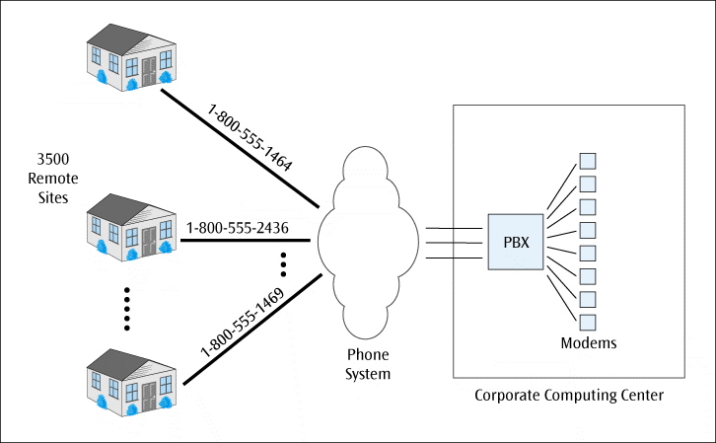
The Internet In Action: A Company Creates a VPN
A fictitious company wants to allow 3500 of its workers to work from home
If all 3500 users used a dial-in service, the telephone costs would be very high
CompuCom employees dialling directly into the corporate computing center
Data Communications and Computer Networks: A Business User's Approach, Eighth Edition
© 2016. Cengage Learning. All Rights Reserved.

Slide 56
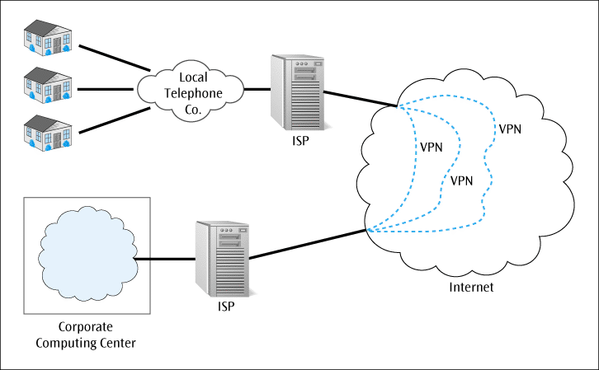
The Internet In Action: A Company Creates a VPN (continued)
Instead, the company will require each user to access the Internet via their local Internet service provider
This local access will help keep telephone costs low
Then, once on Internet, company will provide software to support virtual private networks
The virtual private networks will create secure connections from the users’ homes into the corporate computer system
CompuCom’s employees using a tunnel across the Internet into the corporate computing center
Data Communications and Computer Networks: A Business User's Approach, Eighth Edition
© 2016. Cengage Learning. All Rights Reserved.

Slide 57
Summary
To support Internet, many protocols, such as IP, TCP, ICMP, UDP, ARP, DHCP, and NAT, are necessary
The Internet Protocol provides a connectionless transfer of data over a wide variety of networks
There are currently two versions of IP: IPv4 and IPv6
The Transmission Control Protocol (TCP) resides at the transport layer and provides an error-free, end-to-end connection
The Internet Control Message Protocol (ICMP) performs error reporting for IP

Slide 58
Summary (continued)
The User Datagram Protocol (UDP) provides a connectionless transport layer protocol in place of TCP
The Address Resolution Protocol (ARP) translates an IP address into a CSMA/CD MAC address on a LAN
The Dynamic Host Configuration Protocol (DHCP) allows a network to dynamically assign IP addresses to workstations as they are needed
Network Address Translation (NAT) allows a network to replace local IP address with on global-type IP address

Slide 59
Summary (continued)
Tunneling protocols allow a company to create virtual private network connections into a corporate computing system
World Wide Web is vast collection of electronic documents containing text and images that can be accessed by simply clicking link within browser’s Web page
To locate document on Internet, you usually refer to its Uniform Resource Locator (URL)

Slide 60
Summary (continued)
Internet consists of many commonly used network applications
E-commerce is the buying and selling of goods and services electronically
Cookies store state information on user’s hard drive and provide a way for Web sites to track a user’s Web-browsing patterns and preferences

Slide 61
Summary (continued)
Intranet is in-house Internet with Web-like services that are available only to a company’s employees or to customers and suppliers through an extranet
The Internet continues to evolve with a completely new, higher-speed Internet2

